Slide 1
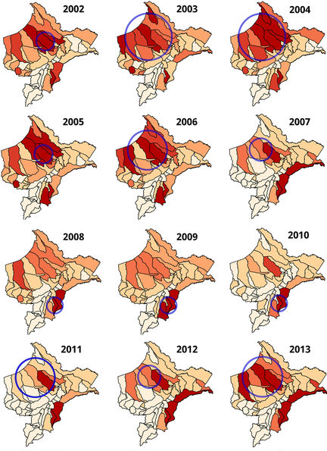
Analyzing spatial clustering

Slide 2
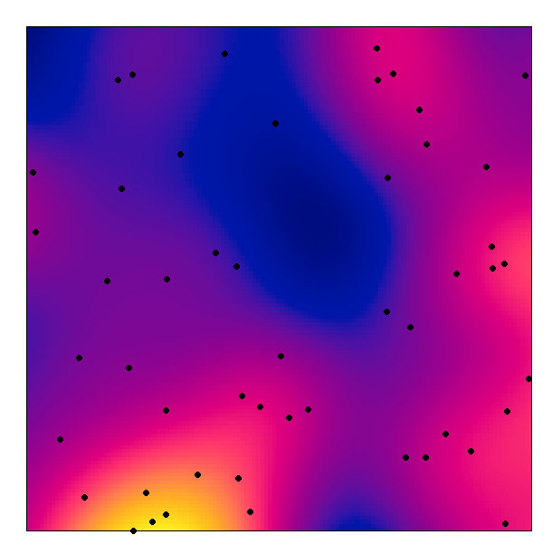
What is clustering?
“Spatial autocorrelation”
"Everything is related to everything else, but near things are more related than distant things.“
Tobler’s First law of Geography
Notes:
Epidemiologically-significant local spatial variation in residual risk.

Slide 3
Mechanisms for clustering
Infectious diseases (direct transmission/ vector distribution)
Shared risk factors (i.e. socioeconomic status)
Health hazards (i.e. localized pollution sources, etc)
Data anomalies with spatial pattern (i.e. reporting bias)

Slide 4
Ways to define clustering
Global vs local clustering methods
i.e. clustering vs cluster detection
Raw vs residual
i.e. corrected for known risk factors
Scale
Clustering likely to happen over multiple scales
Clustering over larger spatial scales (and these tests of association) may mask more local clusters
Notes:
Global – used to assess whether clustering is apparent throughout the study region but do not identify the locations of clusters. Provide a single statistic that measures the degree of spatial clustering and can assess the statistical significance of that statistic.
Local – define the locations and extent of clusters and can be further divided into focused and non-focused tests.
Residual – known risk factors (like age and gender) have been accounted for

Slide 5
Data types
Branches of spatial statistics
Continuous spatial analysis
Discrete spatial analysis
Spatial point processes
Pullan et al (2012)
Notes:
Different approaches are distinguished by basic underlying statistical model and assumptions about the spatial process.
Continuous spatial variation: Assume that the outcome occurs and is potentially measurable throughout space -> can explicitly model spatial variation in the outcome
Discrete spatial variation: Investigate proximity and used with aggregate area level data
Spatial point processes: Concern the physical location of events distributed within a study region and are used to investigate either

Slide 6
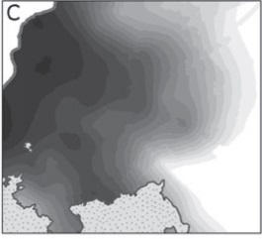
Data types
Branches of spatial statistics
Continuous spatial analysis
Discrete spatial analysis
Spatial point processes
Sampled data
Rely upon spatially sampled measurement data
Global (i.e. model overall spatial autocorrelation in data)
Physical location of events in region
Global propensity to cluster or local spatial clusters of infection
Pullan et al (2012)
Notes:
Different approaches are distinguished by basic underlying statistical model and assumptions about the spatial process.

Slide 7
Data types
Branches of spatial statistics
Continuous spatial analysis
Discrete spatial analysis
Spatial point processes
Sampled data
Point-level count data (prevalence/incidence)
Area-level count data (prevalence/incidence)
Point process data (event)
Notes:
Continuous spatial variation: Assume that the outcome occurs and is potentially measurable throughout space -> can explicitly model spatial variation in the outcome
Discrete spatial variation: Investigate proximity and used with aggregate area level data
Spatial point processes: Concern the physical location of events distributed within a study region and are used to investigate either

Slide 8
Variation amongst attribute values
(aka “first-order spatial effect”)
Variation in the mean
(aka “second-order spatial effect”
Residuals
Macro
Meso
Micro
Large scale trends
Geostatistical: mean of the outcome
Point process: mean intensity
Local dependence of spatial process & smaller scale interactions between neighbors
Geostatistical: autocorrelation
Point process: clusters
Notes:
Conceptualize as variation at different scales, which leads to different spatial effects.

Slide 9
First-order characteristics (macro)
Describe the way in which the expected value (mean or average) of the spatial pattern varies across space (i.e., the density of the spatial point pattern)
May be constant or spatially varying, but assumes that individual event locations are independent of one another (i.e. no spatial dependency).
i.e. where do patterns appear to differ?

Slide 10
Second-order properties (meso-/micro-)
Inform on the interrelationship between events or spatial dependence.
Measures by a dependence measure – e.g. nearest neighbor analysis, Ripley’s k-function
Insight into global aspects of the point pattern
i.e. are there general patterns of clustering with respect to CSR or another pattern?
Notes:
Analysis of these properties can provide different but complementary insight into the process

Slide 11
Point-level vs Point-process data
 | Point-level data | Point process data
Measurement | Could in principle be measured anywhere, but typically come at a limited number of observation locations. | Corresponds to case-ascertainment.
Locations | Sampled locations usually based on “representativeness” or random sampling. | Usually event locations (i.e. incident case) over a given time frame and study region.
Analytic objectives | Pattern of observation locations itself usually not of primary interest – rather to infer aspects of the variable that have not been measured (i.e. prevalence over larger study area) | Determine whether the pattern of event locations contains clusters of events with increased risk of disease.
Outcome | Prevalence/Incidence (count) | Density

Slide 12
Aims of cluster analysis
Are observed patterns ‘random’?
Point-processes define clustering as a departure from this randomness
What is the propensity for spatial clustering or locations of individual clusters (places with excess cases)?
Surveillance systems
Where are areas with higher than expected risk?
Target interventions to high risk areas; detect potential outbreaks
Over what scale does clustering occur?
Determine the optimal scale of interventions

Slide 13
Main types of tests for spatial clusters
Global statistics
propensity for clustering anywhere in the study area, e.g. Ripley’s K-function, Cuzick & Edwards test for point data and Moran’s I for area data
Local statistics
cluster(s) in specific locations, e.g. Spatial scan statistic for point data and Getis and Ord’s local Gi(d) statistic for area data
Focused statistics
cluster(s) around a specific point source, e.g. Diggle’s method, Stone’s test, Bithell’s test
Notes:
Global Measures
A single value which applies to the entire data set
The same pattern or process occurs over the entire geographic area
An average for the entire area
Local Measures
A value calculated for each observation unit
Different patterns or processes may occur in different parts of the region
A unique number for each location

Slide 14
Global and Local tests for spatial clustering: point-level and area data

Slide 15
Data
Point-level & area-level data: reported counts of incident (newly diagnosed) or prevalent (existing) cases residing in particular areas within the study area
Point prevalence of malaria in Burkina Faso
Point prevalence of malaria in Ethiopia
Area level incidence of lip cancer in Scotland

Slide 16
Autocorrelation statistics
Provide an estimate of the degree of spatial similarity observed among neighboring values of an attribute (i.e. disease prevalence) over a study area.
Requires:
Definition of neighbors (distance-based or adjacency)
Weights matrix (those close in space given greater weight)

Slide 17
Defining neighbors
Adjacency
first-order
Second-order
Distance-based
NB: may choose distance that allows each point/polygon at least one neighbor OR define spatial lags

Slide 18
Defining spatial weights
In order to calculate summary statistics, you have to assign spatial weights to each relationship
Binary: used with fixed distance, K nearest neighbors, and contiguity spatial relationships. Neighbors =1, non-neighbors=0
Variable: For inverse distance or inverse time spatial relationships, weights fall into a range from 0 to 1 with nearby neighbors getting larger weights than neighbors farther away.
Rule of thumb – stick to binary representation unless you know about the spatial process.
Default in R is “W” where the weights are standardized to sum to unit (aka row standardization).

Slide 19
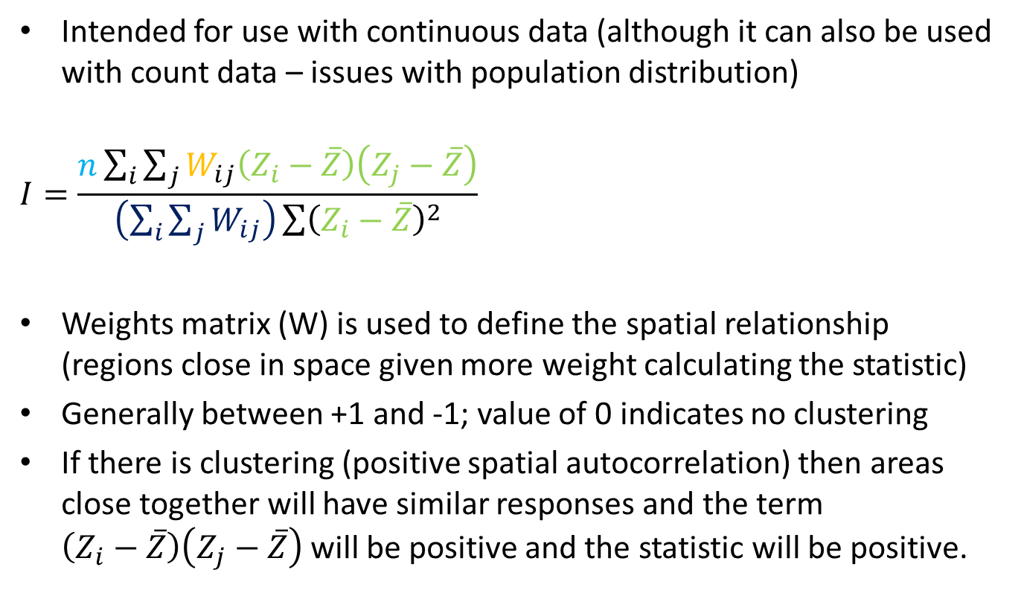
Moran’s I statistic
Intended for use with continuous data (although it can also be used with count data – issues with population distribution)
$$I=\frac{n\sum_{i}{\sum_{j}{W_{ij}\left(Z_{i}−\overline{Z}\right)\left(Z_{j}−\overline{Z}\right)}}}{\left(\sum_{i}{\sum_{j}{W_{ij}}}\right)\sum{{\left(Z_{i}−\overline{Z}\right)}^{2}}}$$
Weights matrix (W) is used to define the spatial relationship (regions close in space given more weight calculating the statistic)
Generally between +1 and -1; value of 0 indicates no clustering
If there is clustering (positive spatial autocorrelation) then areas close together will have similar responses and the term $\left(Z_{i}−\overline{Z}\right)\left(Z_{j}−\overline{Z}\right)$ will be positive and the statistic will be positive.
Weights matrix
Deviation of feature attribute from mean
Total number of features
Aggregate of all the spatial weights
Notes:
Where the cross product of the difference between the values (Z) and the mean ($\overline{Z}$), calculated for locations i and j according to a weights matrix ($W_{ij}$), are summed over all n locations. In this case, a binary weights marix was used based on the minimum distance required to allow all points at least one neighbour (56 km). The significance of the resulting statistic is assessed using Monte Carlo randomisation within R.

Slide 20
Correlogram of Moran’s I
Series of estimates of Moran’s I evaluated at increasing distances and plotted against one another – can help to determine where spatial autocorrelation is maximized.

Slide 21
Hypothesis testing
Use simulation (Monte Carlo randomization) to assess the significance of clustering
i.e. does the observed spatial pattern differ significantly from the null hypothesis of complete spatial randomness
Calculate the test statistic using the observed data and then re-calculating it using a specified number of simulated data sets (or permutations).
Expected distribution of the test statistic under the null hypothesis
Calculate the likelihood of obtaining the value for the test statistic derived from the observed data and expressed as the p-value = the proportion of the test statistic value (from the simulated data) that are greater than the value of the test statistic from the observed data.

Slide 22
Local Indicators of Spatial Association (LISAs)
Global measures assume that the spatial process is stationary – if this is not true than tests can obscure local effects.
Particularly an issue with larger datasets because they summarize large amounts of potentially dissimilar information
LISAs scan the whole dataset but only measure dependence in limited portions of the study area
Detection of disease clusters……

Slide 23
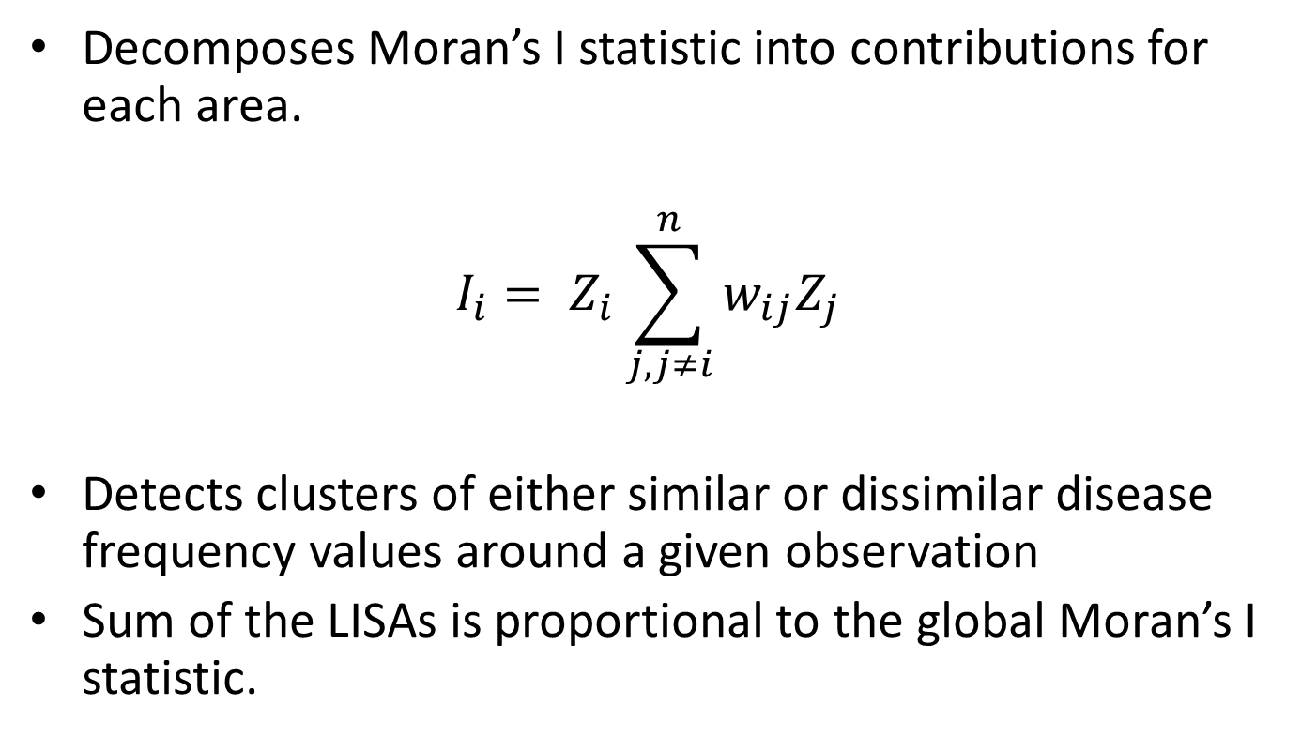
Local Moran’s
Decomposes Moran’s I statistic into contributions for each area.
$$I_{i}= Z_{i}\sum_{j, j≠i}^{n}{w_{ij}Z_{j}}$$
Detects clusters of either similar or dissimilar disease frequency values around a given observation
Sum of the LISAs is proportional to the global Moran’s I statistic.

Slide 24
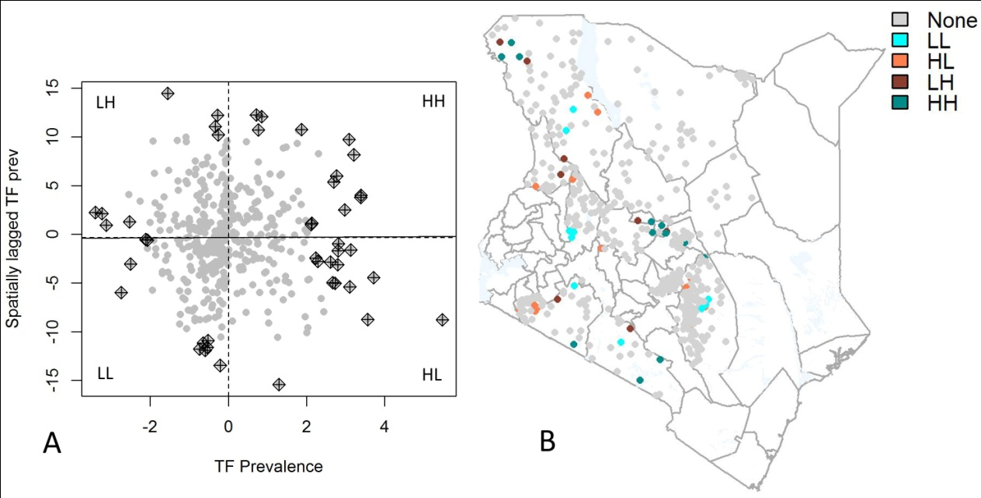
Notes:
Figure 5.5 Local Moran’s I scatterplot with the global Moran’s I regression line fitted (A) and map of clusters with residual values above or below 2 standard deviations away from the origin (B). Positive spatial autocorrelation, or clustering of similar values, is indicated by Low-Low (LL) and High-High (HH) associations between neighbouring points, while negative spatial autocorrelation indicates association of dissimilar values: high values surrounded by low neighbouring values (HL) and low values surrounded by high values (LH) associations.

Slide 25
Example and in-class exercises
Import point malaria prevalence data from Burkina Faso
Visualize data
Calculate global Moran’s I and a correlogram
Calculate local Moran’s I
In class exercise: assess using the point level data from Ethiopia

Slide 26
Introduction to point processes

Slide 27
Data
Case-control point data: point locations for each of a set of cases reported and a collection of non-cases (controls). “Marked point data”
Malaria cases and population controls from Namibia

Slide 28
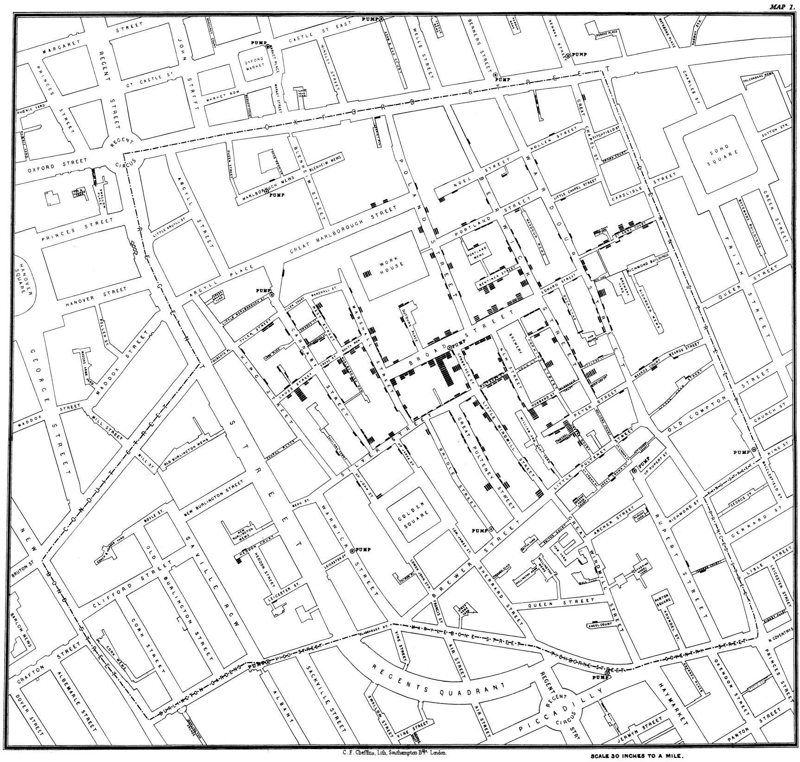
Broad Street Cholera Outbreak John Snow ~ 1854
Notes:
Famous outbreak of cholera in Soho in London in 1854. John Snow mapped fatalities and did one of the first spatial analysis, in which he calculated the number of cases within defined distances of different pumps. Led to correct ID of the pump (probably too late).
Weaknesses in approach?
In epidemiology, need to correct for spatial variation in underlying population density in order to assess for evidence of ‘clustering’ of cases of disease

Slide 29
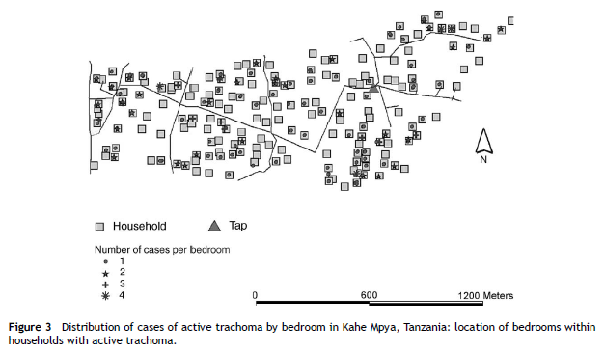
Properties of spatial point patterns
A point pattern is a set of locations
in a defined study region at which
events of interest have been
recorded
Key terms
Event – an occurrence of interest (e.g. incident case of disease)
Point – any location in the study area where an event could occur
(Event) Location – specific location where an event did occur
Data set – collection of observed event locations and a spatial domain of interest
Polack et al (2005)

Slide 30
General forms of point patterns
Clustered – some points clustered together, other areas contain no points
Random – a given point is equally likely to occur at any location and independent of other points
Regular – each point is as far from neighbour as possible

Slide 31
What is a point process?
An observed point pattern that can be described by a spatial stochastic process (probabilistic model)
Any observed spatial point pattern can be considered an outcome (or a realisation) of a spatial stochastic process – i.e. a data set resulting from a particular model
Typically a Poisson process

Slide 32
Components of a point process
First-order (mean) properties
Describes the expected density of points through space.
Measured by an intensity measure, e.g. quadrat estimation, kernel estimation (next lecture)
Second-order properties
Informs on the interrelationship between events of the process
Similar to variance and covariance
Summarize spatial dependence between events over different spatial scales

Slide 33
Complete spatial randomness (CSR)
Homogeneous Poisson process (HPP)
Simplest theoretical model for a spatial point pattern (stationary; independence of points)
Events are distributed independently according to a uniform probability distribution over the region
Used as a benchmark for hypothesis testing – not useful if departure is obvious due to a priori heterogeneity (e.g. underlying population distribution)

Slide 34
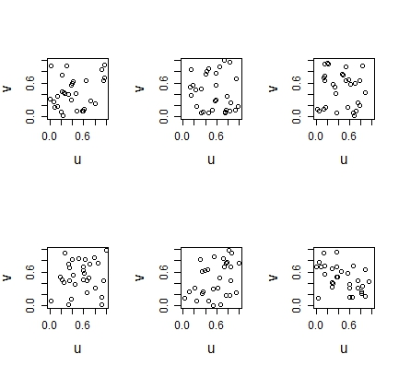
CSR II
Intensity of events is constant at all locations in the study area = homogenous
Realizations from the model can appear different

Slide 35
HPP vs IPP
Assumption of stationary is restrictive– the intensity is almost never constant in the study area.
We expect more cases in areas with more people at risk
Risk may vary in space with other covariates (e.g geographic variations in population size / the amount of rainfall at a location)
Heterogenous/inhomogenous Poisson process allows for spatially varying first-order (mean) property of the process, where the intensity measure depends on other variables
Non-stationary

Slide 36
Edge effects
Boundaries of edges of an area may be incompatible (arbitrary), unavailable (another country) or non-existent (next to an ocean)
Points or area-units near edges will have fewer neighbors, which will be problematic when calculating mean intensity or test statistics for clustering.
Corrections usually use a weighting system to give less weight to observations at the edge

Slide 37
Global tests for spatial clustering using point (event) data

Slide 38
Ripley’s K function
Second-order analysis: Identifies the distance at which clustering occurs, based on the expected number of events within a distance, without regard to shape of study area and assuming no 1st order effects
lambda is the average density (intensity) of points (expected number of points per unit area).
$$K \left(h\right)= \frac{E[number of events within h of a randomly chosen event]}{λ}$$
Λ = 23/4 = 5.75
Notes:
$Λ$ is the density (number per unit area) of events

Slide 39
Observed spatial pattern
Expected random spatial pattern
Lower & upper confidence envelopes
K-function
Significant dispersion at larger distances
Significant clustering at smaller distances
Distance
When observed K value is larger than the expected K value for a particular distance, the distribution is more clustered than a random distribution at that distance. When the observed K value is smaller than the expected K, the distribution is more dispersed than a random distribution at that distance. Statistical significance indicated by envelopes

Slide 40
Limitations
Assumes stationary process
K-function just for cases may not be useful due to variations in the spatial distribution of the population at risk

Slide 41
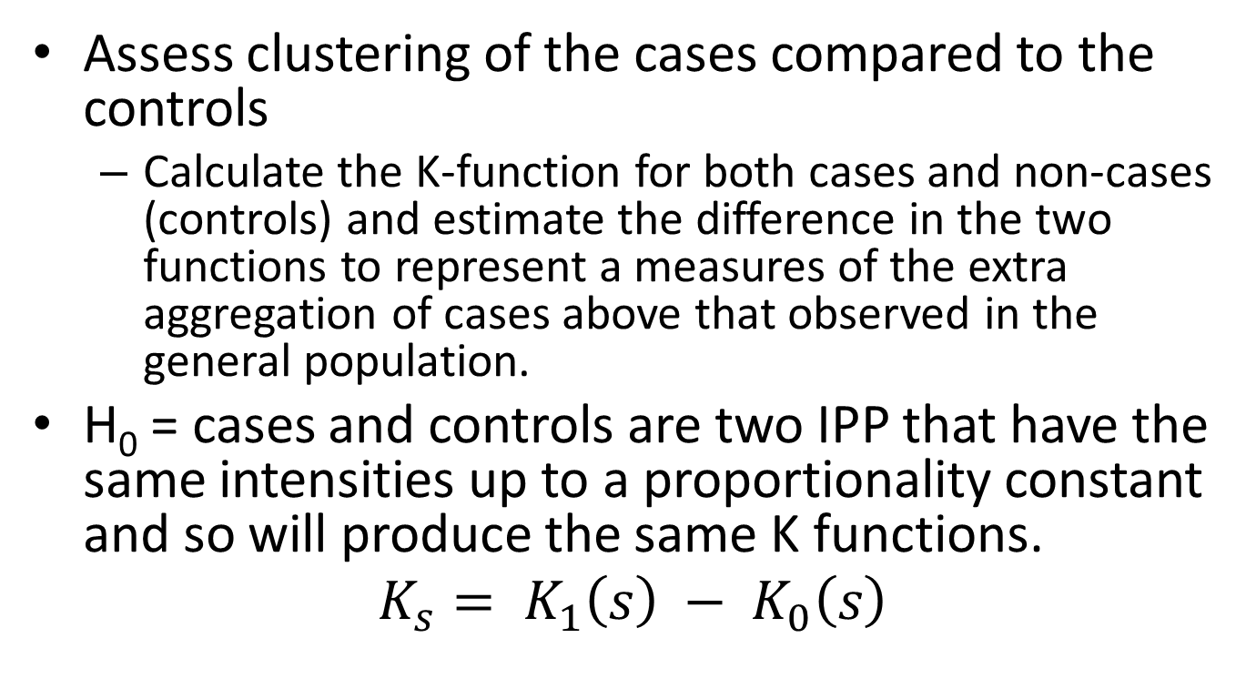
Difference in K-functions
Assess clustering of the cases compared to the controls
Calculate the K-function for both cases and non-cases (controls) and estimate the difference in the two functions to represent a measures of the extra aggregation of cases above that observed in the general population.
H₀ = cases and controls are two IPP that have the same intensities up to a proportionality constant and so will produce the same K functions.
$$K_{s}= K_{1}\left(s\right) − K_{0}\left(s\right)$$

Slide 42
Hypothesis testing
Monte Carlo randomization can be used to randomly permute the locations of cases and non-cases (controls)
Values of the difference function D(s) is computed for each permutation and then upper and lower bounds plotted.
Can use ClusterSeer or the splancs package in R

Slide 43
Example and in-class exercises
Visualize data
Use the case data characterize clustering using Ripley’s K
Is clustering present in the dataset?
Over what scale is clustering present?
What are the limitations of this approach
Estimate the difference in K-function for cases and controls

Slide 44
Spatial scan statistics
Calculations of intensity and K-functions not in many packages – other tests based on properties of heterogenous point process (i.e. number of events follows Poisson distribution)
Scan statistics – based on comparisons of local rate estimates
Does the ratio of cases to controls (or cases per population at risk) appear “significantly” elevated in certain areas
Similar to the comparison of intensity functions
Goal is to detect specific clusters where the observed rate (or ratio) is inconsistent with the rate (or ratio) over the rest of the study area.

Slide 45
Kulldorff’s spatial scan statistic
This test detects spatial clusters based on a significant excess of cases within a moving cylindrical (or elliptical) window that systematically visits all spatial locations. Can be used for discrete (non-random and fixed locations) and continuous scan statistics (locations are random).
Different types of probabilistic models for discrete scan statistics according to the underlying distribution of the population at risk.
Poisson: number of events in a geographical location is poisson-distributed, according to a known underlying population at risk
Bernoulli: 0/1 event data such as cases and controls
Ordinal: Ordered categorical data
Exponential: Survival time data
Normal: Other types of continuous data
Notes:
Sample of overlapping circles of different sizes created and used by SaTScan

Slide 46
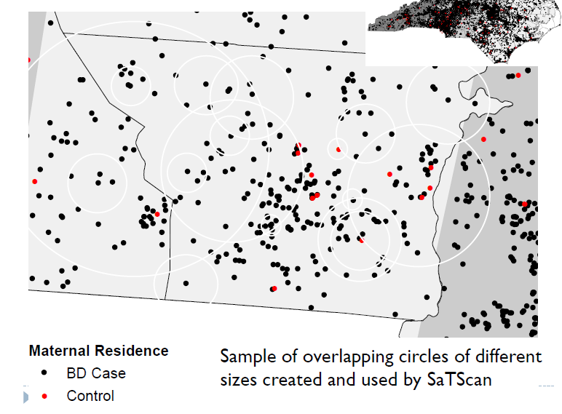
H₁ : there is an elevated risk within the window as compared to outside, for each location and size.
H₀: The risk of an event is the same within and outside the window
Create a grid of points (either as grid or population unit locations) throughout area
Creates an infinite number of circles of varying sizes around each point, maximum size = fixed proportion of pop.
Control
Malaria case
Notes:
This test uses a circular window that moves systematically throughout the geographic space to identify significant clustering of cases. The window is centred on each of a number of possible locations throughout the study area and at each location, the window size varies from zero to a pre defined upper limit (often 50% of the study population, which allows both small and large clusters to be detected, while ignoring clusters that contain more than 50% of the population). For each location and size of the scanning window, a likelihood ratio test is conducted to test the hypothesis that there is an elevated rate of disease as compared with the distribution outside. The window size and location with the maximum likelihood is defined as the “most likely” cluster (i.e. least likely to have occurred by chance). The distribution and p-value of the most likely and secondary clusters are determined by conducting Monte Carlo replications of the data set.

Slide 47
For each circle:
Obtain actual and expected number of events inside and outside the circle
Expected number of cases in each unit is proportional to the size of the population at risk
Calculate the likelihood function – likelihood of finding the observed number of events in each circle’
6/20 = 0.3
11/132 = 0.08
Household location
Control
Malaria case
Notes:
Scan statistic provides a measure of how unlikely it would be to have the observed number of cases, using the likelihood ratio test
Significance testing using permutations of stimulated
Extension to spatiotemporal clustering

Slide 48
Data input
Data can be either aggregated by administrative unit or other geographical level, or there may be unique coordinates for each observation.
SaTScan™ adjusts for the underlying spatial variation of a background population.
It can also adjust for any number of categorical covariates, as well as for temporal trends, known space-time clusters and missing data.

Slide 49
Common SatScan models
Poisson model: where the number of events in an area is Poisson distributed under the null hypothesis. Number of cases is compared to the background population data and the expected number of cases is proportional to the size of the population at risk in each circle.
Bernoulli model: with 0/1 event data such as cases and controls, where non-cases are taken to represent the background distribution population.

Slide 50
In-class assignment: SatScan analysis
Do the SatScan practical using the case control data
Compare SatScan results using spscan.test in the “smacpod” library in R
NB: there is now an rsatscan package that runs SatScan from R.

